Slide 1

Basic Pronunciation Review
Notes:
Created by Educational Technology Network. www.edtechnetwork.com 2009

Slide 2
Phonemic Alphabet | Vocabulary and Concept | Intonation | Pronunciation | Language
10 | 10 | 10 | 10 | 10
20 | 20 | 20 | 20 | 20
30 | 30 | 30 | 30 | 30
40 | 40 | 40 | 40 | 40
50 | 50 | 50 | 50 | 50

Slide 3
Phonemic Alphabet - 10
Say this tongue twister with the correct pronunciation of “th” sounds
There those thousand thinkers were thinking, “how did the other three thieves go through?”

Slide 4

Phonemic Alphabet – 10
There those thousand thinkers were thinking, “how did the other three thieves go through?”
Remember that your tongue is on your teeth. Otherwise the pronunciation is incorrect.

Slide 5
Phonemic Alphabet - 20
Voiced or Unvoiced?
Sound | Voicing
/p/
/v/
All vowel sounds
/ʃ/ (“sh”)
/tʃ/ (“ch”)

Slide 6
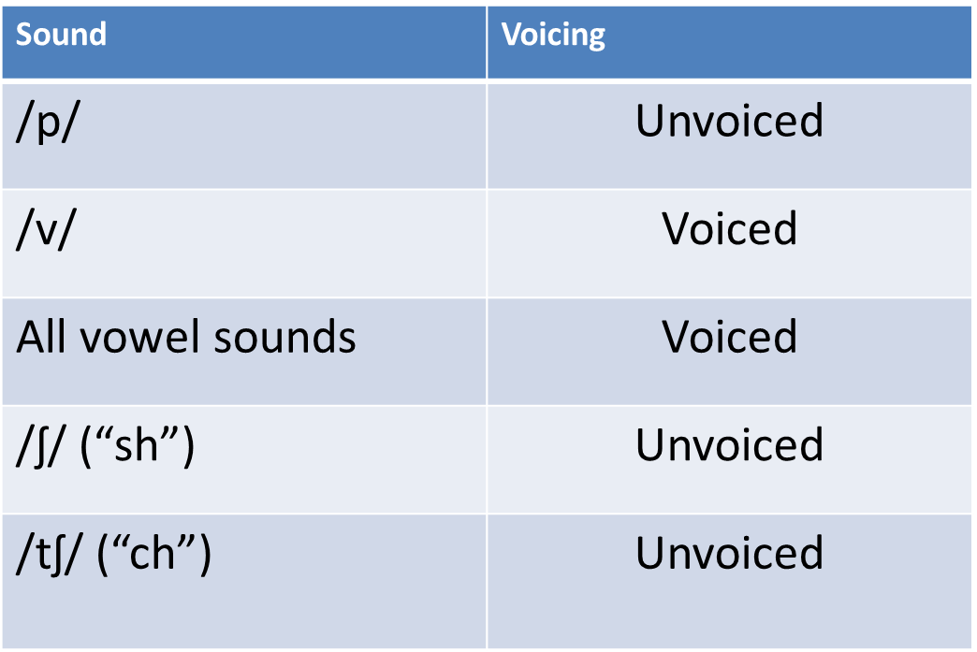
Phonemic Alphabet – 20
The “ch” and “sh” sounds use the same mouth position and they are both unvoiced. The difference is that the “sh” is a long, continuous sound, and the “ch” is a short, burst of air.
https://www.youtube.com/watch?v=SyIUJh5iC4I
/ʃ/ (“sh”) | /tʃ/ (“ch”)
Wash | Watch
Shoe | Chew
Shop | Chop
Cash | Catch

Slide 7
Phonemic Alphabet - 30
Pronounce these words;
Customer
Tasks
Mister (Mr.)
Tests
Experience

Slide 8
Phonemic Alphabet – 30
Remember to pronounce all of the consonants in the cluster. We need them all so focus on strong /s/ sounds.
Customer
Tasks
Mister (Mr.)
Tests
Experience (“eksperience”)

Slide 9
Phonemic Alphabet - 40
What is the proper pronunciation of the /ts/ sound?
Let’s
It’s
That’s
Cats
Sits
Invites

Slide 10
Phonemic Alphabet – 40
http://www.rachelsenglish.com/videos/how-make-ts-sound
Tongue goes forward and up, on the back of your teeth, to block the air for the /t/ and then releases the air for the /s/

Slide 11
Phonemic Alphabet – 50
Which sound is used to replace the full form vowel (strong form) in unstressed syllables or words?

Slide 12
Phonemic Alphabet – 50
/ə/
“It’s for him” -> “It’s /fə/ him.”
Canada -> /kænədə/
Economy -> /Ikɒnəmi:/

Slide 13
Vocabulary and Concept - 10
What’s the purpose of
structure words?

Slide 14
Vocabulary and Concept – 10
Structure Words
Words that are only used for proper grammar. They don’t give us any information so we can typically speak them in a “weak form”
Conjunctions (and/or)
Pronouns (I/you/he/they)
Positive Auxiliaries (can/would/could)
Prepositions (in/on/around/under)

Slide 15
Vocabulary and Concept - 20
What are the three ways to check understanding to make sure that a message is clear?

Slide 16
Vocabulary and Concept – 20
Speaker asks the listener if they understand
Are you with me?
Did you get that?
Listener politely interrupts and tells the speaker when they don’t understand
I’m not quite with you
I don’t understand
What did you say?
Can you please say that again? I didn’t quite get you
Listener can give a summary of the information to make sure it’s correct
“Let me just check that I’ve got it right, you said ________”
“Just to confirm, you said _____________”

Slide 17
Vocabulary and Concept - 30
How do you speak a word differently to emphasize your point?
(there are three ways)

Slide 18
Vocabulary and Concept – 30
Louder
“I really don’t want to go.”
Longer (extending the vowel)
It was sooooo much fun
Pause after the word
I said, I think that we should walk (pause) instead of drive

Slide 19
Vocabulary and Concept - 40
When do we use intonation to emphasize our point?
(There are three situations)

Slide 20
Vocabulary and Concept – 40
Expressing Strong Feelings
Normal Statement: It was really good
Strong Feelings: It was “reeeeaaallllyyy” good.
Disagreement
Normal Statement: I don't think so, it I thought it was horrible.
Disagreement: I don't think so, I thought it was horrible.
Giving Corrections
Normal Statement: I said I want the blue one.
Giving a Correction: I said I want the blue one.
*We can emphasize both content words and structure words

Slide 21
Vocabulary and Concept - 50
Adj: Someone who can speak fluently. They are usually good at speaking in front of a group.
“His presentation was very easy to understand because he was so _____________ .”

Slide 22
Vocabulary and Concept – 50
Articulate: Someone who can speak fluently. They are usually good at speaking in front of a group.
“His presentation was very easy to understand because he was so articulate .”

Slide 23
Intonation - 10
Ask me this question.
“You won’t be able to finish this task today, will you?”

Slide 24
Intonation – 10
“You won’t be able to finish this task today, will you?”
True questions, when the answer is unknown, usually use a rising tone.

Slide 25
Intonation - 20
Read this list with the correct intonation.
“I like the weather, the people, the environment, and the food.”

Slide 26
Intonation – 20
“I like the weather, the people, the environment, and the food.”
When saying a list, your intonation should rise on all items except for the last where it will fall.

Slide 27
Intonation - 30
Which words are stressed in each sentence?
“He can finish it today.”
“He can’t finish it today.”

Slide 28
Intonation – 30
“He can finish it today.”
“He can’t finish it today.”
Negative words are always stressed
Can’t, don’t, won’t, couldn’t, etc.
The stress pattern will help you understand American pronunciation because they reduce the final sound quite often
http://www.rachelsenglish.com/videos/can-vs-cant

Slide 29
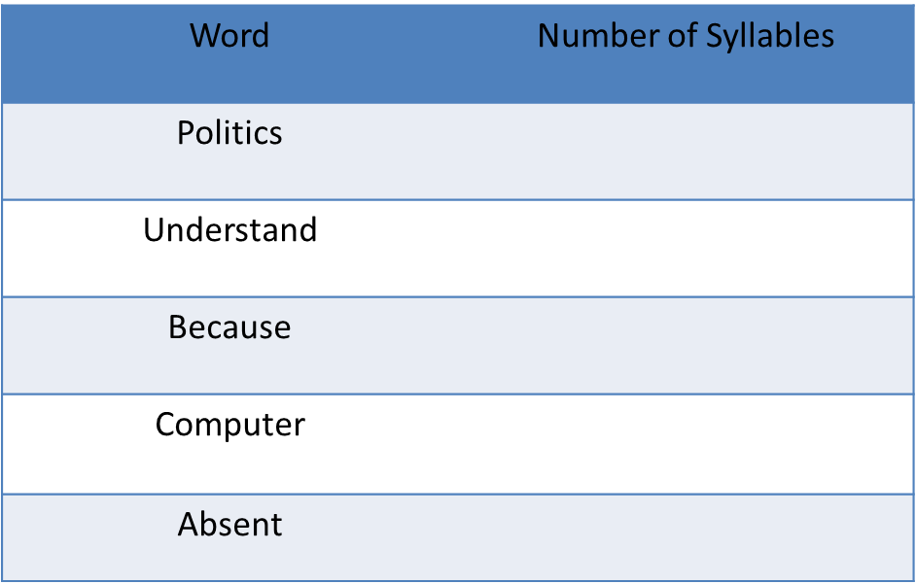
Intonation - 40
Count and underline the stressed syllable in these words

Slide 30
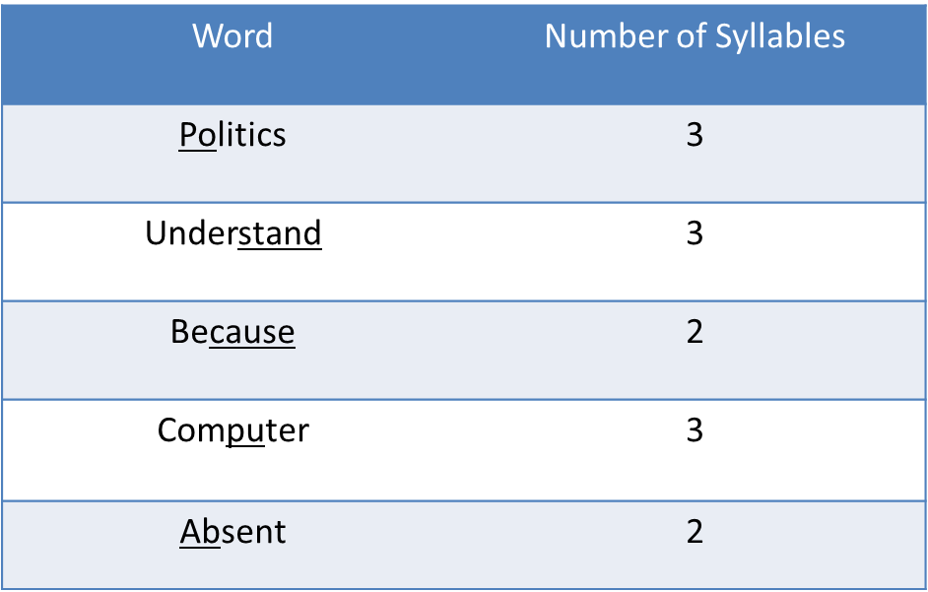
Intonation – 40

Slide 31
Intonation - 50
Underline the stressed words in this dialog;
A: Goodbye, I’ll see you tomorrow at 5:00pm.
B: No, I’ll see you Monday at 5:00pm.

Slide 32
Intonation – 50
A: Goodbye, I’ll see you tomorrow at 5:00pm.
B: No, I’ll see you Monday at 5:00pm.
When giving a correction, the wrong information will be emphasized the most. We still speak the content words clearly, but the corrected information will be emphasized.

Slide 33
Pronunciation - 10
Use a contraction to complete this sentence.
“___________ been working here for a long time.”

Slide 34
Pronunciation – 10
“___________ been working here for a long time.”
Positive | Negative
I’ve = I have | I have not = I haven’t
You’ve = You have | You have not = You haven’t
He’s = He has | He has not = He hasn’t
She’s = She has | She has not = She hasn’t
We’ve = We have | We have not = We haven’t
They’ve = They have | They have not = They haven’t

Slide 35
Pronunciation - 20
What’s the reduced form of
“have to”?

Slide 36
Pronunciation – 20
/hæftə/ or /hæftʊ/
The words “have to” is usually pronounced as one word.
“I /hæftə/ leave now”
“I /hæftʊ/ eat lunch at 12:00pm”

Slide 37
Pronunciation - 30
Make this statement past tense
“I want to go to the cinema but I can’t because I need to study English.”

Slide 38
Pronunciation – 30
“I wanted to go to the cinema but I couldn’t because I needed to study English.”
Remember the special endings on the verbs ending in /d/ or /t/
Want | Need
Wanted /Id/ | Needed /Id/

Slide 39
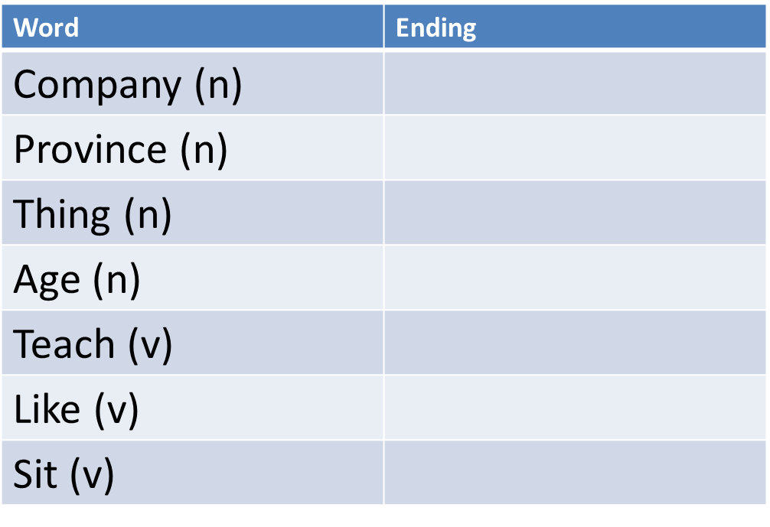
Pronunciation - 40
Plural -s and Present Simple Verb Tense: Special Ending or Normal?

Slide 40
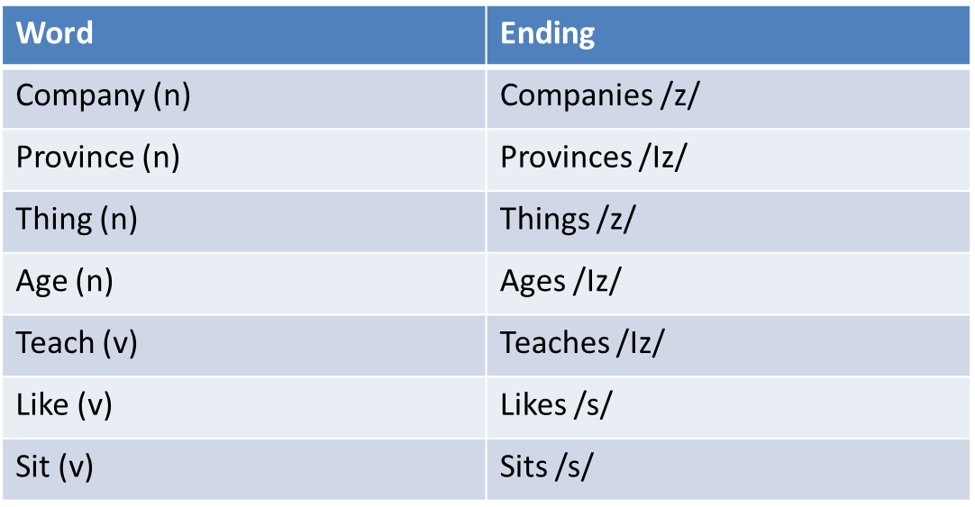
Pronunciation – 40
Video about plural nouns (*but also applies to the pronunciation of present simple tense verbs): http://www.rachelsenglish.com/videos/plural-nouns

Slide 41
Pronunciation - 50
/d/ /t/ or /Id/ Ending?
Base Verb | Past Tense Ending
Talk
Attend
Complain
Enjoy
Help
Expect

Slide 42
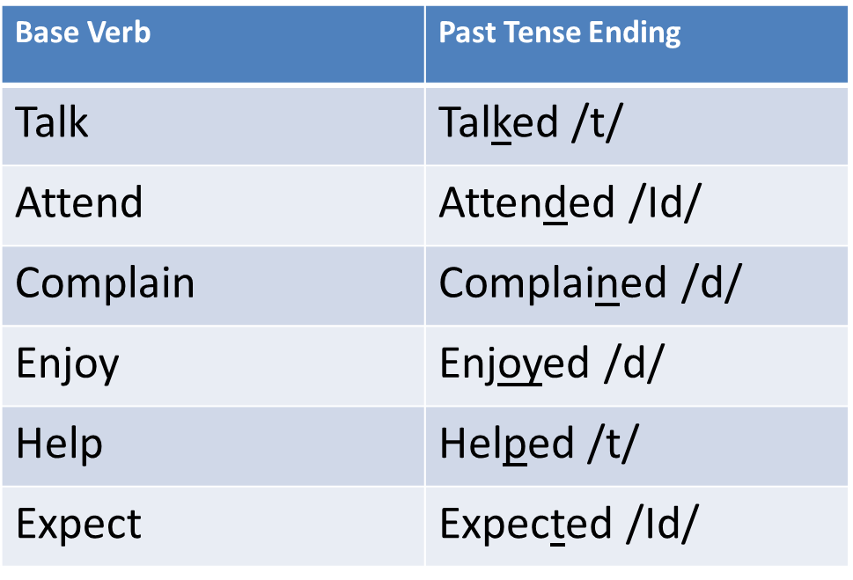
Pronunciation – 50
/d/ if the base verb ends with a voiced sound
/t/ if the base word ends with an unvoiced sound
/Id/ if the base word ends with a /d/ or /t/, and you must add an extra syllable

Slide 43
Language - 10
Speak this statement with strong feelings.
“I love learning English.”

Slide 44
Language – 10
“I ‘loooooooove’ learning English!”
Speak the emphasized words;
Louder
Longer
With a pause after

Slide 45
Language - 20
Your listener appears confused. Check in with them to see if they understand.

Slide 46
Language – 20
Check in with your listener to make sure that they understand your message. Try to avoid giving a lot of information all at once to make it easier for them to understand. It also gives them an opportunity to ask questions if needed.
Are you following me?
Did you get that?
Am I making myself clear?
Does all of this make sense?
Are you okay so far?

Slide 47
Language - 30
The speaker is talking very fast and you don’t understand what they are saying. Politely interrupt them to get the information that you need.

Slide 48
Language – 30
Sorry, you've lost me
I didn't catch what you just said
I'm not quite with you
I’m sorry, I didn’t quite get that. Can you please repeat what you just said?
Could you please talk a little more slowly?
Don’t be afraid to politely interrupt to ask a question or clarify the information. Especially in western culture, questions and polite interruptions are very, very common.

Slide 49
Language - 40
Disagree with this statement;
“Google is one of the worst companies in the world to work for.”

Slide 50
Language – 40
“Google is one of the worst companies in the world to work for.”
Express Strong Feelings and Disagreement
I don’t think so. I think it’s one of the best.
Express Disagreement and Give a Correction
In my opinion, it’s one of the best companies to work for.

Slide 51
Language - 50
Confirm this message;
“I want you to do Task A first, report back the results, and then start on
Task B. Did you get that?”

Slide 52
Language – 50
A: “I want you to do Task A first, report back the results, and then start on Task B. Did you get that?”
B: “Let me just confirm, you said that you want me to work on Task A first and then let you know the results. And after that I should start Task B. Is that right?”
Give a summary of the statement, placing emphasis on the unclear information. Questions for checking understanding should always use a rising tone.

